Slide 1
PSY 1406: Primate FaceNet Detection
Group Members: Andrew Byun, Julia Casas, Ethan McFarlin, and Claire Suen

Slide 2
Research Questions
- How does FaceNet perform on non-human face recognition tasks?
- What role do gender and age play in FaceNet’s detection capabilities?
- Can FaceNet help us gain insight into visual indicators of evolutionary similarity?
- Does FaceNet prove useful in differentiating between species?

Slide 3
Hypothesis
While FaceNet will be able to distinguish between individual chimps (by some statistically significant margin), it will struggle with more advanced face recognition tasks along the axes of gender, age, and interspecies identification.
To test this theory, we will pass input images from annotated datasets of chimps, rhesus macaques, and Japanese Monkeys into FaceNet and compute statistical analysis on the euclidean distance scores.
We will break this analysis into 4 questions and carry out independent euclidean distance computations for each of them.

Slide 4
Question 1
Can FaceNet identify individual chimps?

Slide 5
Dataset and Wrangling
Name: Alexander Freytag and Erik Rodner and Marcel Simon and Alexander Loos and Hjalmar Kühl and Joachim Denzler: "Chimpanzee Faces in the Wild: Log-Euclidean CNNs for Predicting Identities and Attributes of Primates", German Conference on Pattern Recognition (GCPR), 2016.
Cleaned Data: 50 chimp images. Half of the images are of the same chimp named ‘Fredy’. The other half of the images depict different chimps.

Slide 6
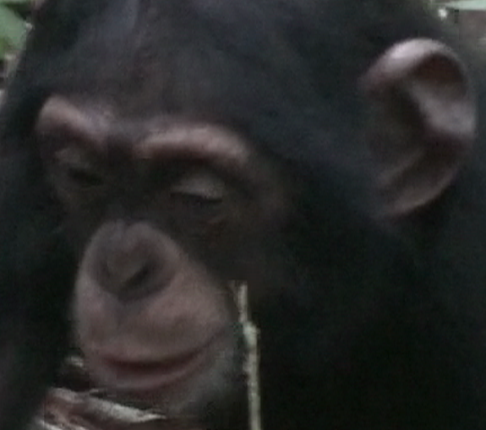
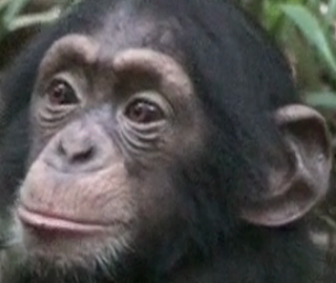
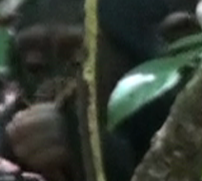
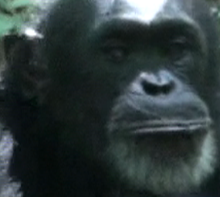
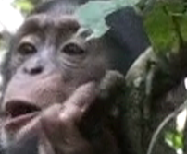
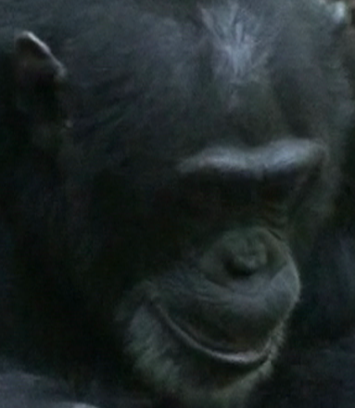
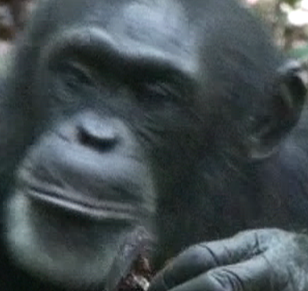
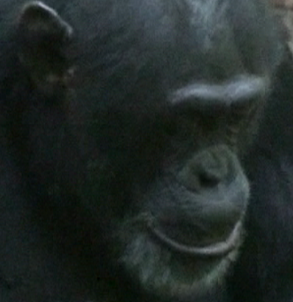
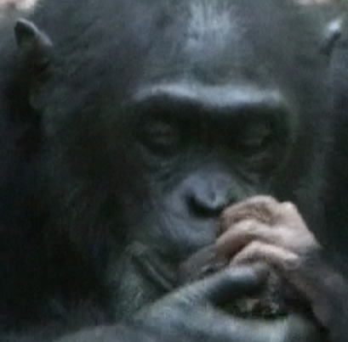
Negative/Positive/Anchor Images
Positive: 49 Other Fredy Images
Negative: 50 Non-Fredy
Chimp Images
Anchor: Fredy
(Image ID #54)

Slide 7
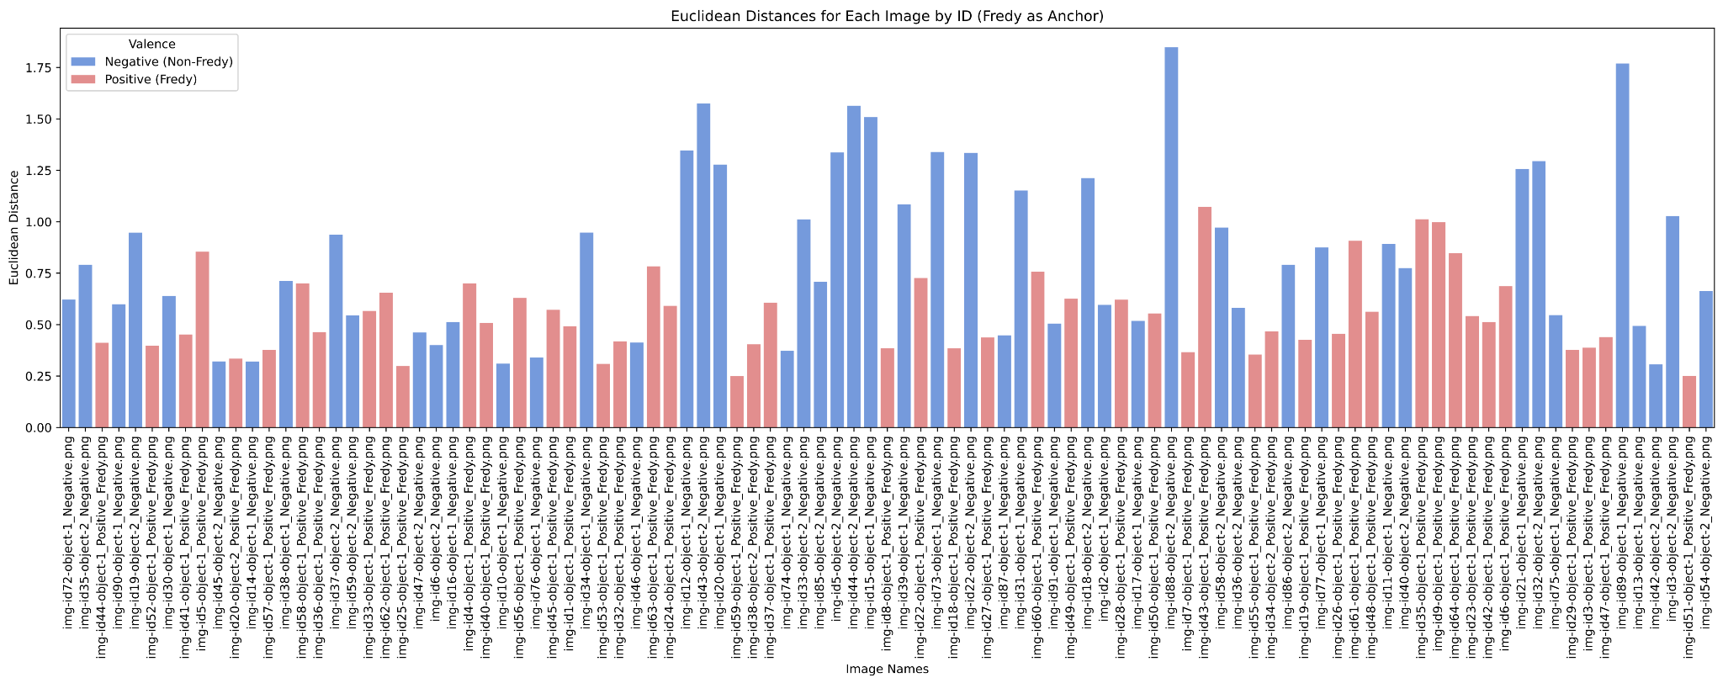
Notes:
Fredy ID: -4.629450042388837 1.1372165432910855e-05

Slide 8
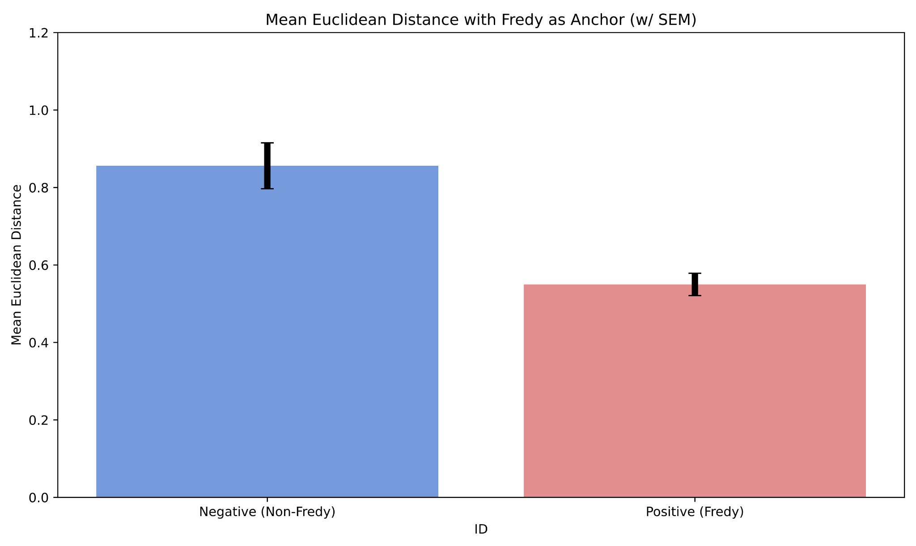
Fredy vs Non-Fredy:
P < 2e-5

Slide 9
Question 2
Can FaceNet discriminate between gender within species?

Slide 10
Description of Dataset (Question 2-4)
Name: PrimFace (Face database of non-human primates)
https://visiome.neuroinf.jp/primface/
Primate Types: Japanese Monkey, Rhesus Macaque, Chimpanzee with metadata on gender and age
30 Images of n=3 for each of the primate types were used

Slide 11
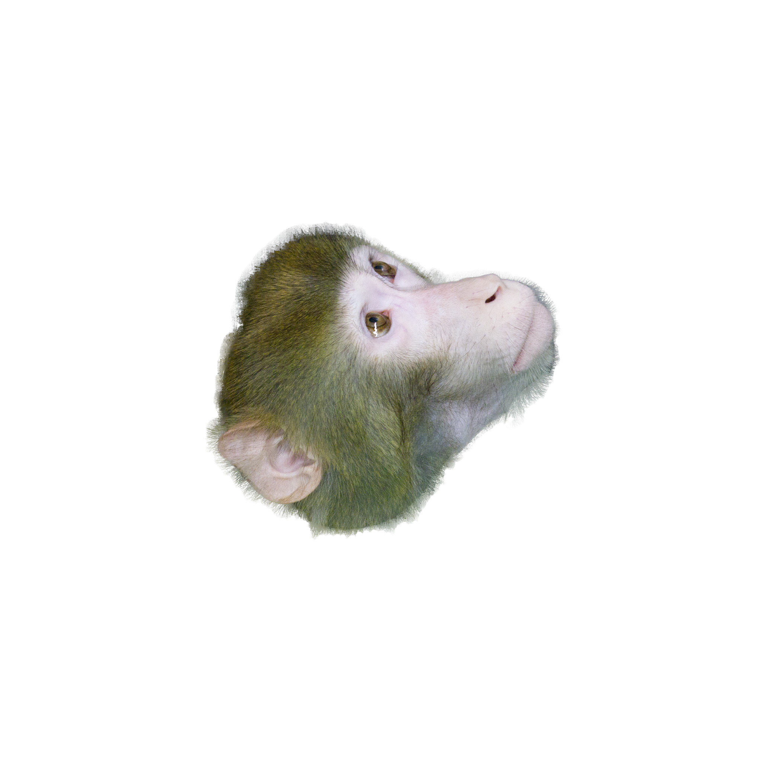
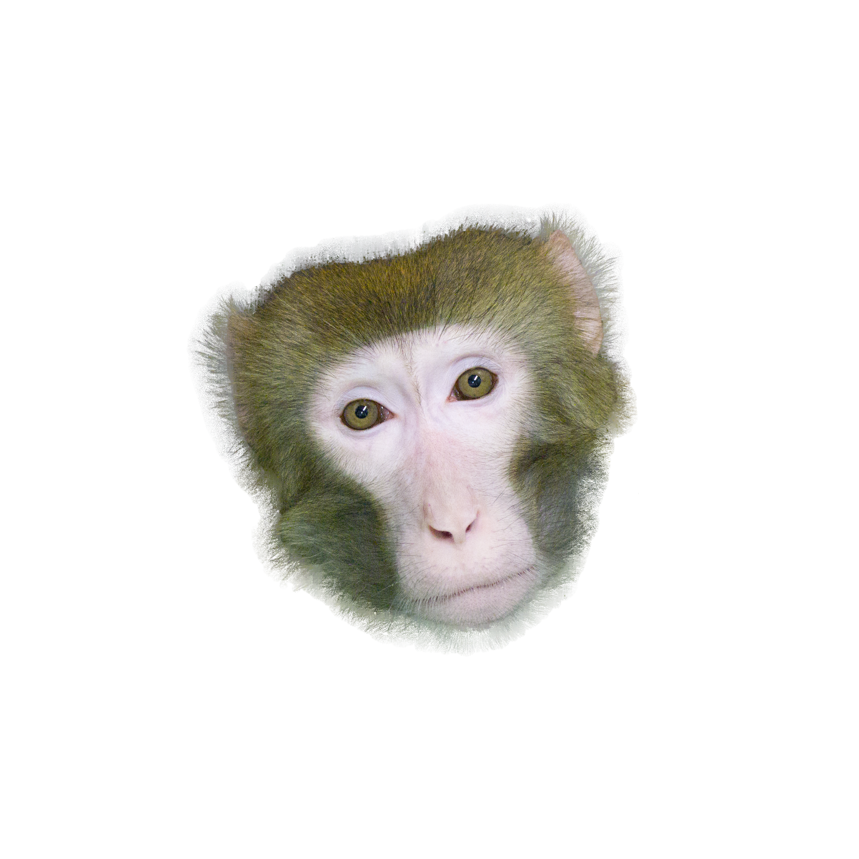
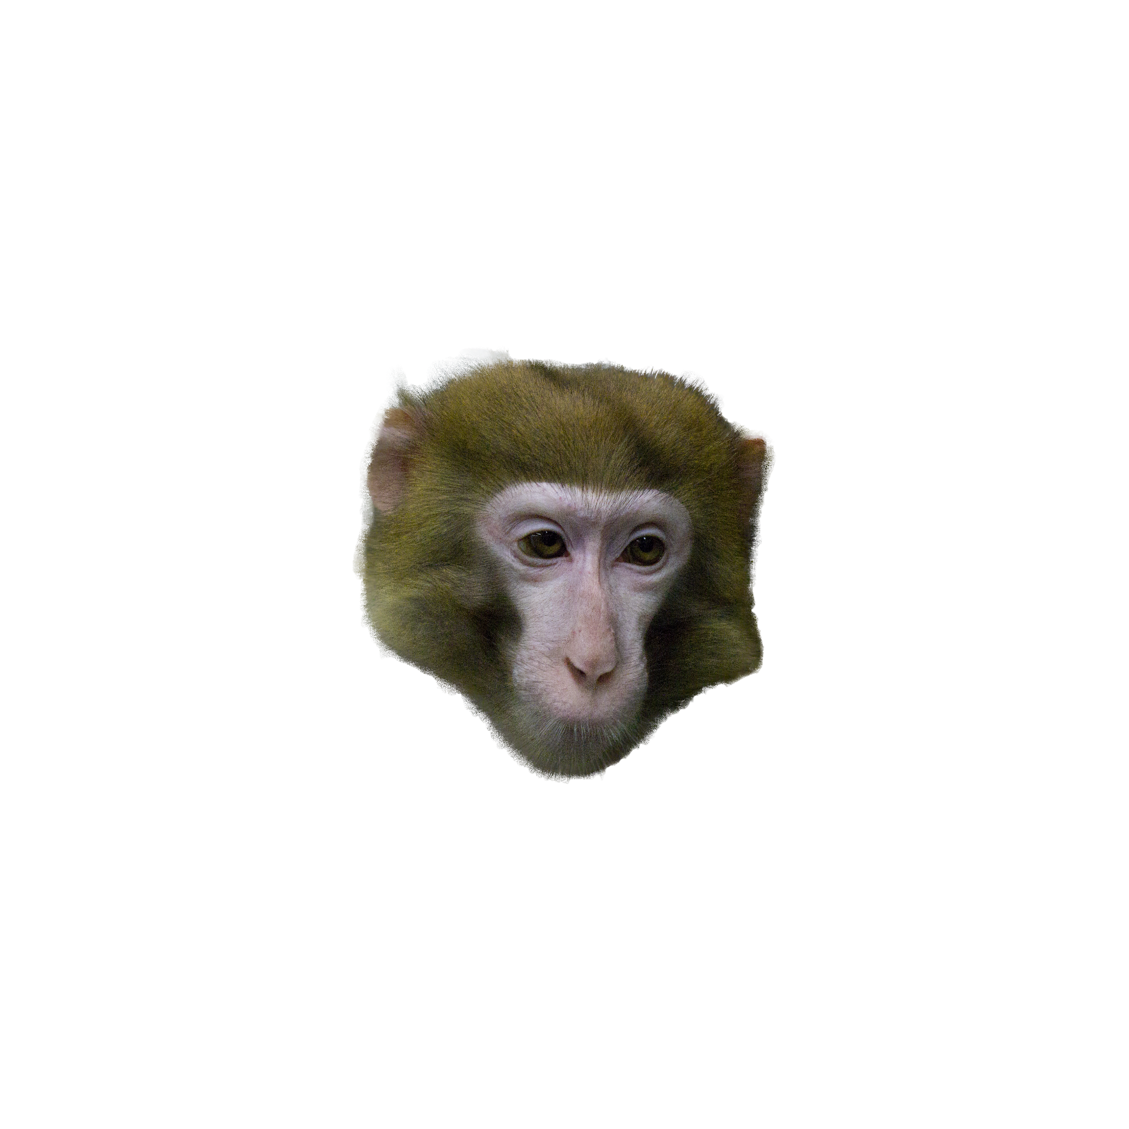
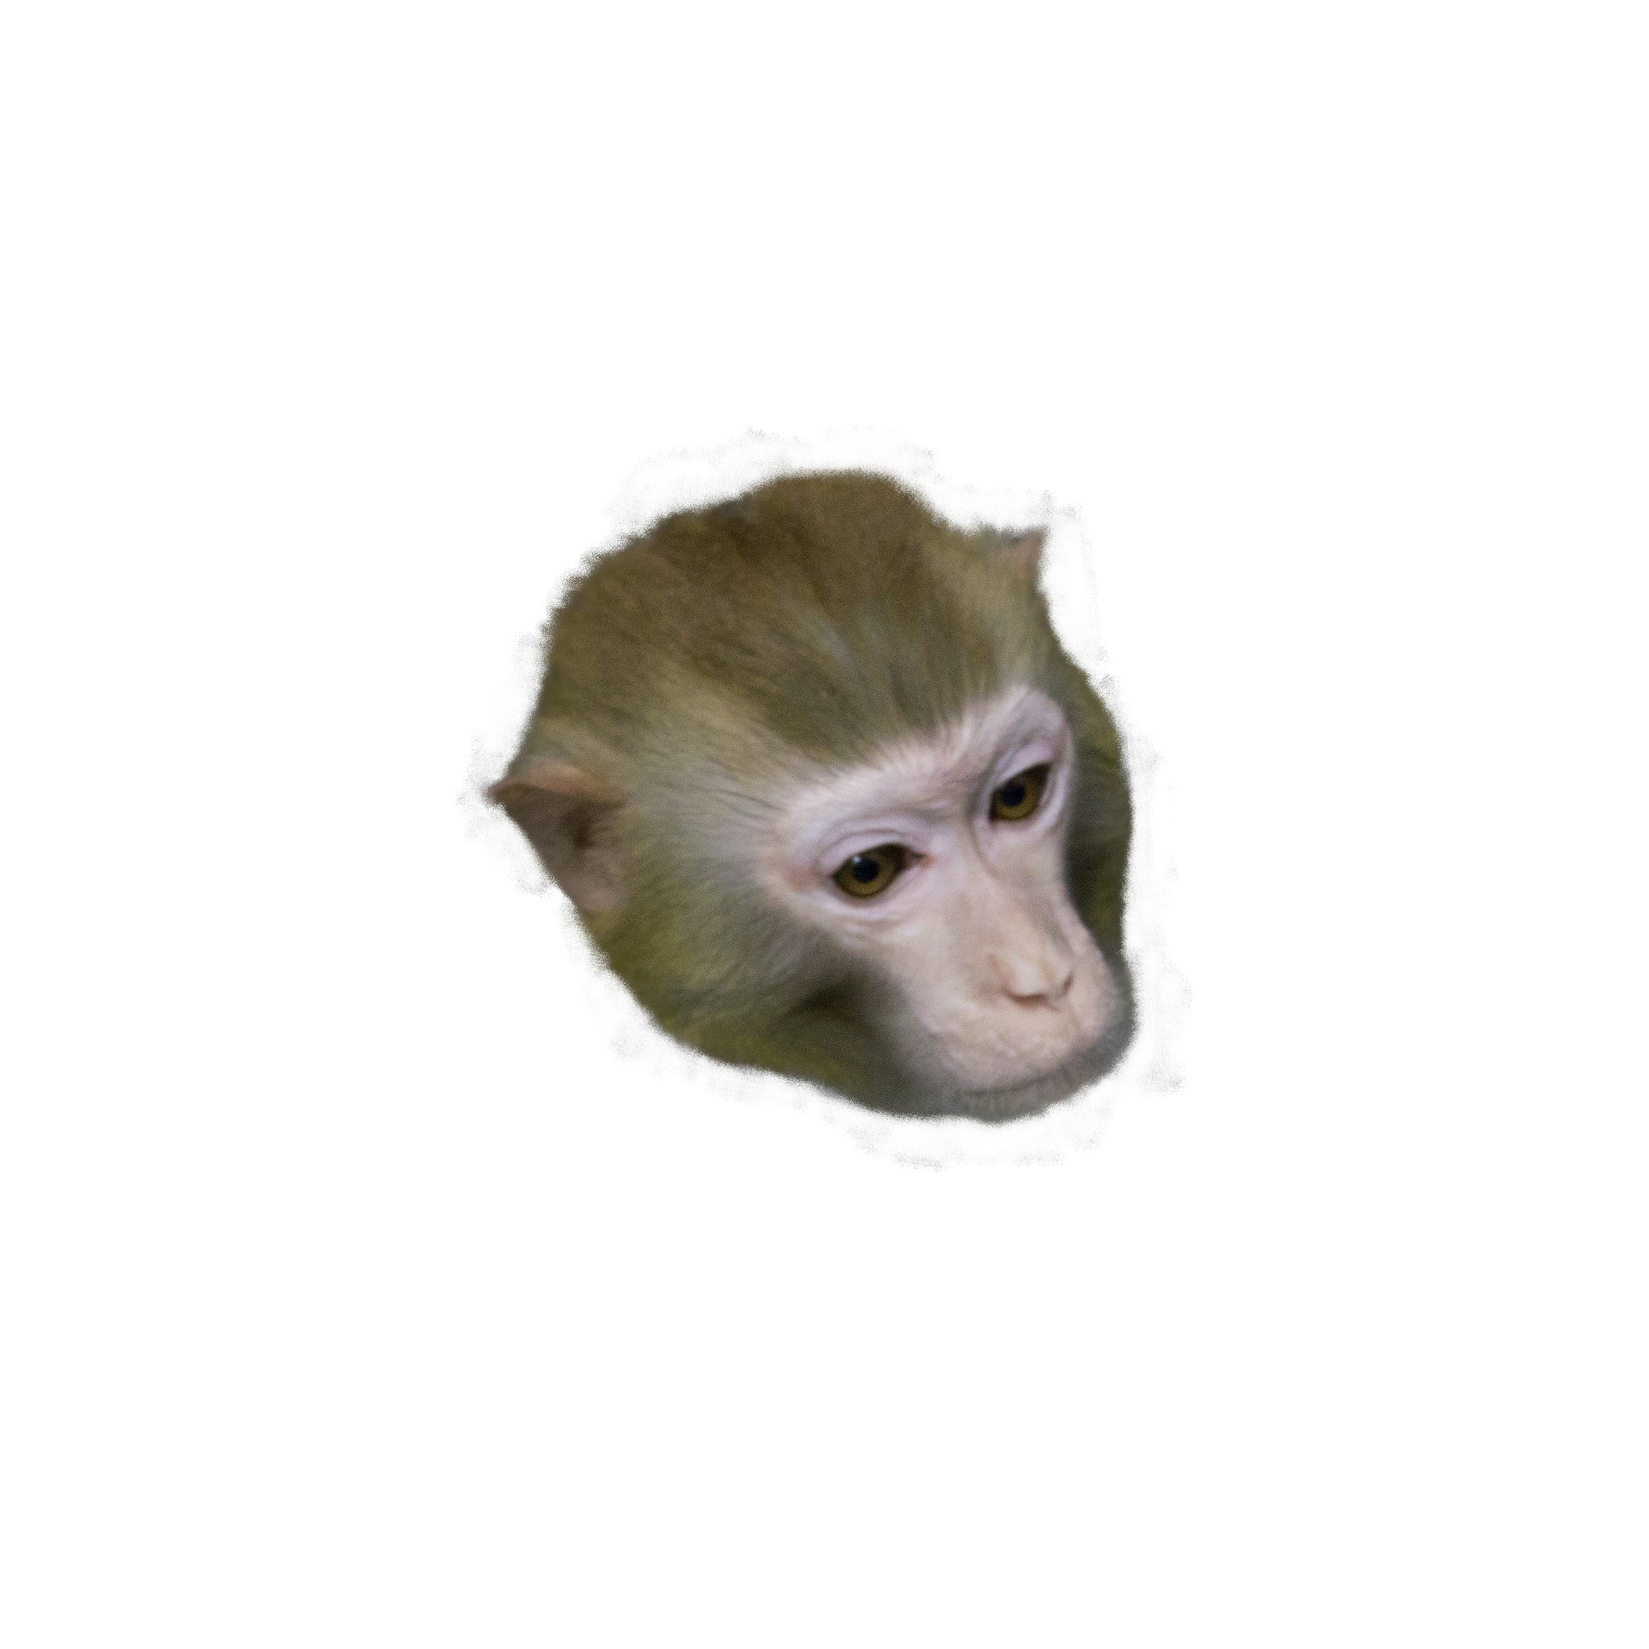
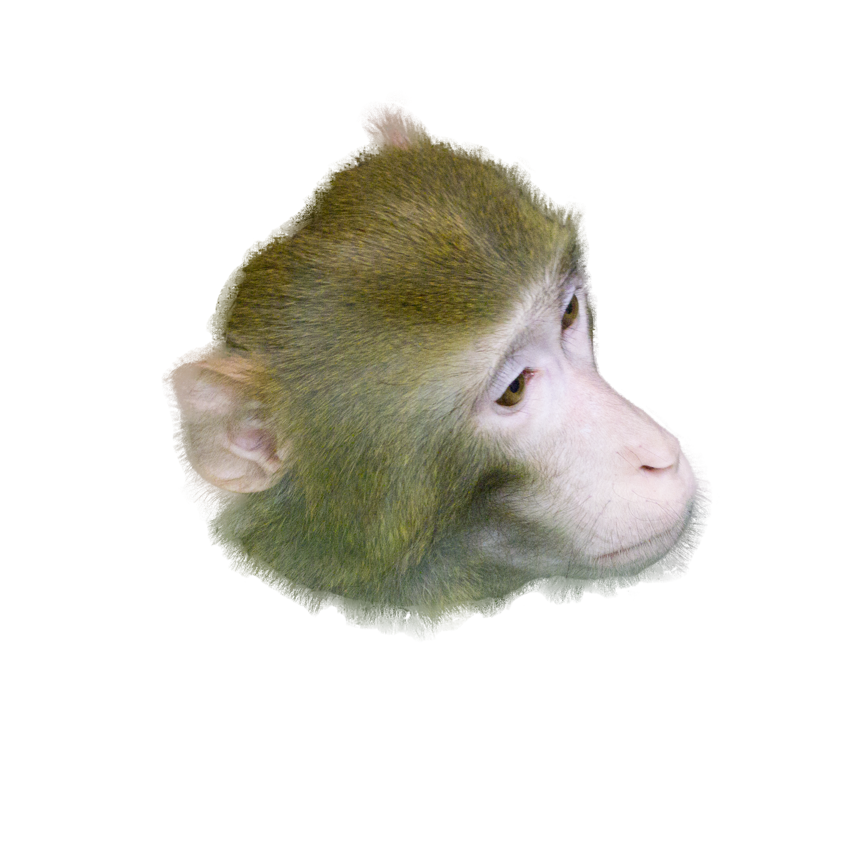
Negative/Positive/Anchor Images
Anchor:
Rhesus Macaque
(Female/Age:5)
Positive:
Rhesus Macaque
(Female/Age:5)
Different angled images
Negative:
Rhesus Macaque
(Female/Age:20)
Rhesus Macaque
(Male/Age:5)
This design allows us to investigate discriminative capacity of FaceNet on Rhesus Macaque gender, but also Age (Question 3)

Slide 12
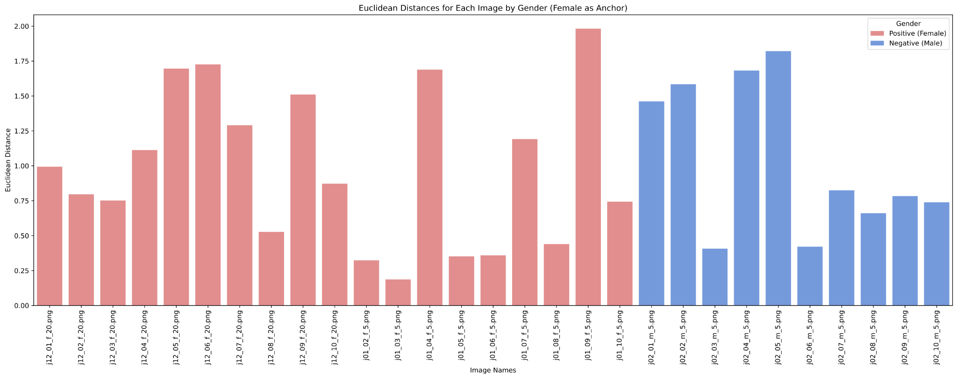

Slide 13
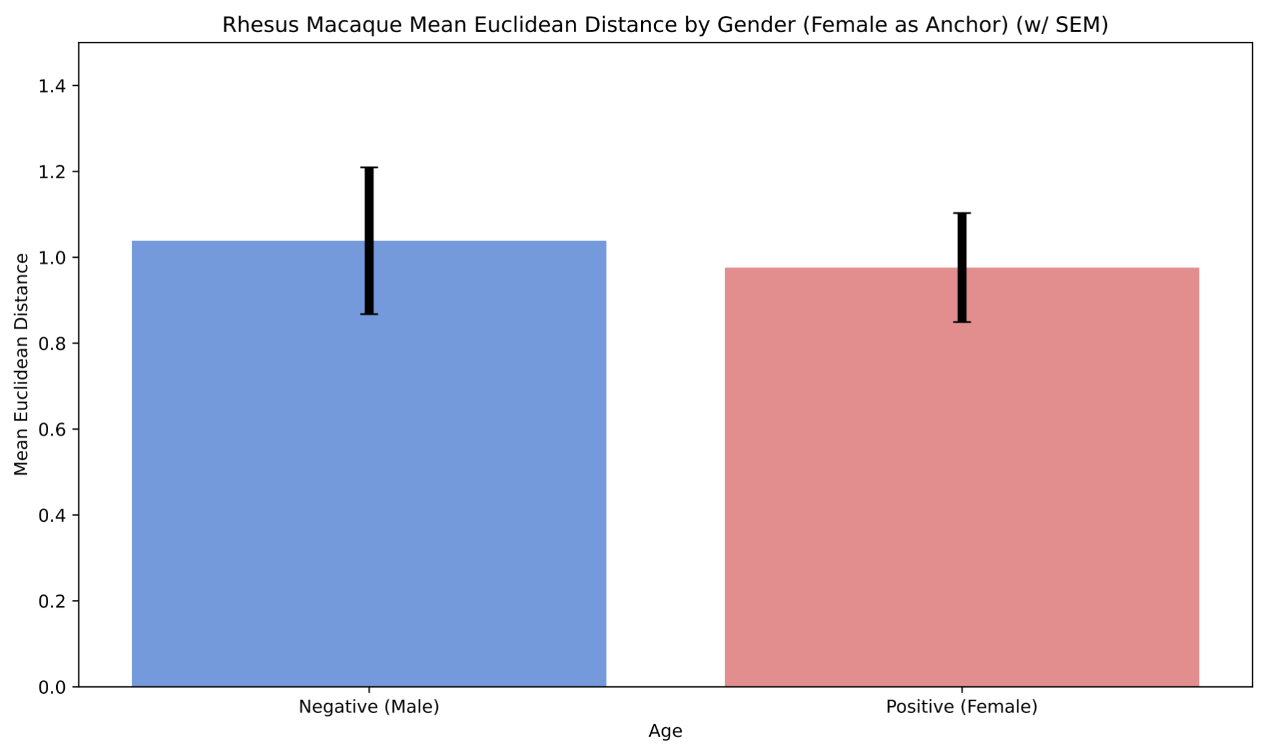
NS

Slide 14
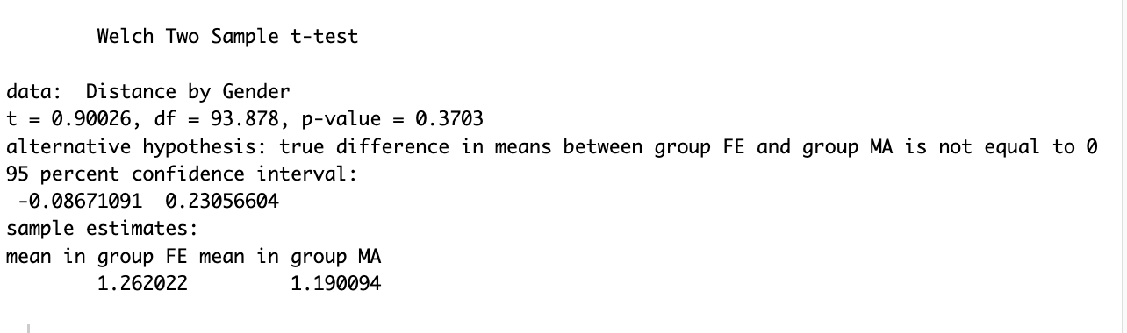
Can Facenet recognize males more accurately than females?

Slide 15
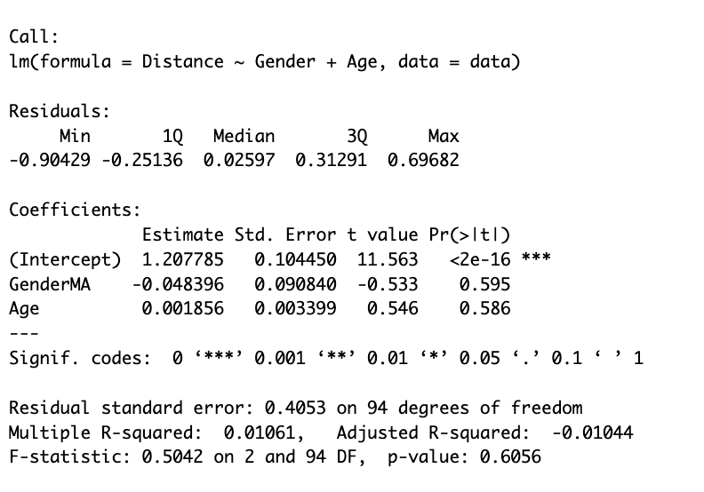
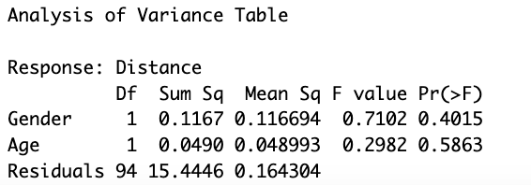
Can Facenet recognize males more accurately than females, controlling for age?

Slide 16
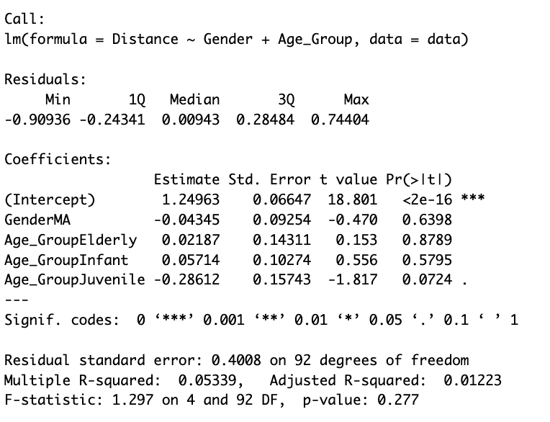
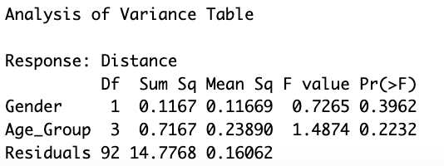
Can Facenet recognize males more accurately than females, controlling for age groups?

Slide 17
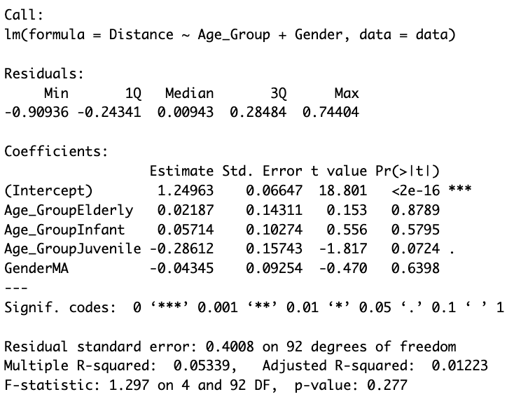
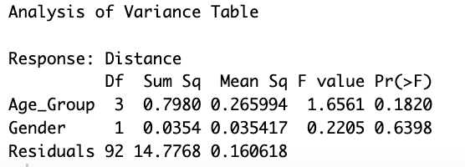
Exploratory Analysis: Can we predict euclidean distance based on age group while controlling for gender?

Slide 18
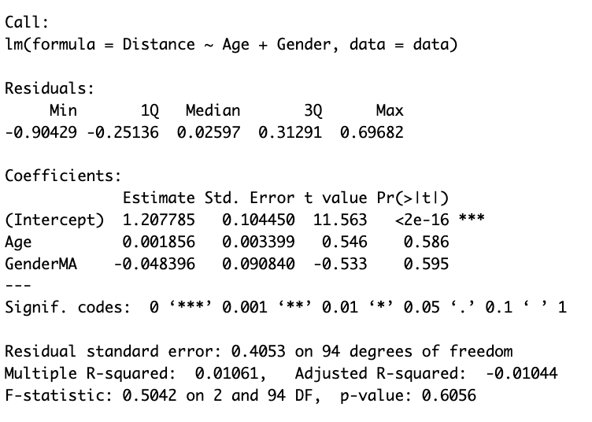
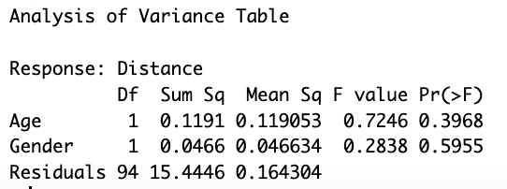
Exploratory Analysis: Can we predict euclidean distance based on age group while controlling for gender?

Slide 19
Discussion (Broad)
Facenet’s sensitivity to Chimp faces:
Training data bias
Feature emphasis discrepancy: Facenet is trained to emphasize and distinguish among human faces (eye spacing, facial symmetry, etc) which might not be as pronounced in Chimps
Facial structure and variability differences: can lead to misinterpretation or overlooked by algorithm
Gender differences in chimp:
gender differences are not pronounced enough to be detected
Age as a confounding factor:
Sample Size and Study design:
Can replicate using different chimps as “anchor”
if effect size is small, larger sample sizes are necessary to detect significant differences

Slide 20
Discussion (Algorithm)
Triplet Loss Function: used to ensure that an image of a specific person’s face is closer to all other images of the same person than to any image of any other person in the dataset
Chimps: struggle with subtle differences or misaligned of features
CNN: used for feature extraction, tuned to human facial features (eyes, noses, mouths) in specific configurations and proportions
Embedding layer: Used to compare faces and determine similarity

Slide 21
Question 3
Can FaceNet discriminate age within species?

Slide 22
Negative/Positive/Anchor Images
Anchor:
Rhesus Macaque
(Female/Age:5)
Positive:
Rhesus Macaque
(Female/Age:5)
Different angled images
Negative:
Rhesus Macaque
(Female/Age:20)
Rhesus Macaque
(Male/Age:5)
This design allows us to investigate discriminative capacity of FaceNet on Rhesus Macaque gender, but also Age (Question 3)

Slide 23
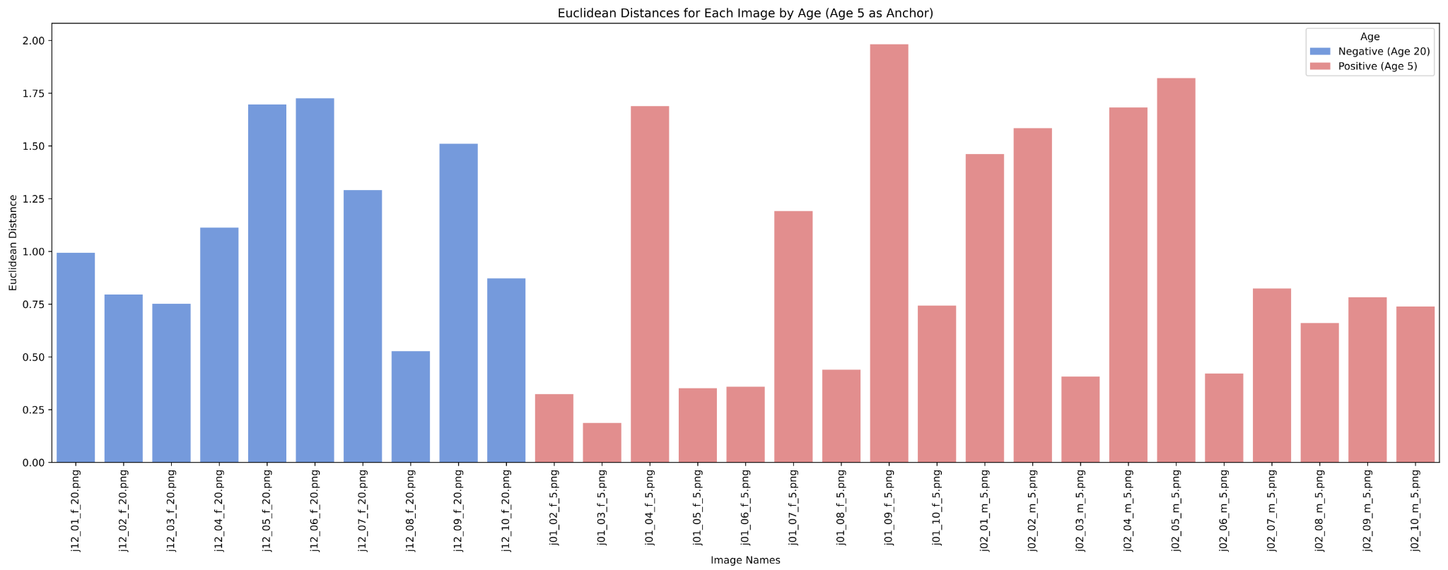
NS

Slide 24
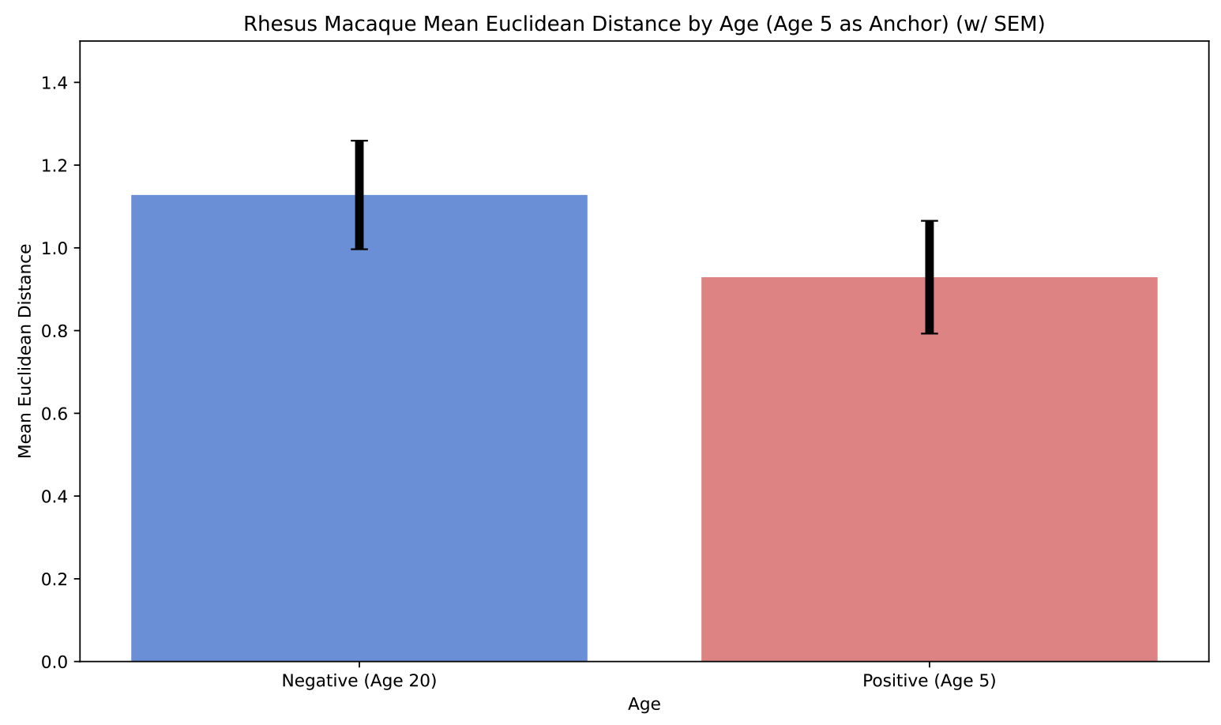
NS

Slide 25
Question 4
Can FaceNet discriminate across species? (Chimps vs Rhesus vs Jap. Monkey)

Slide 26
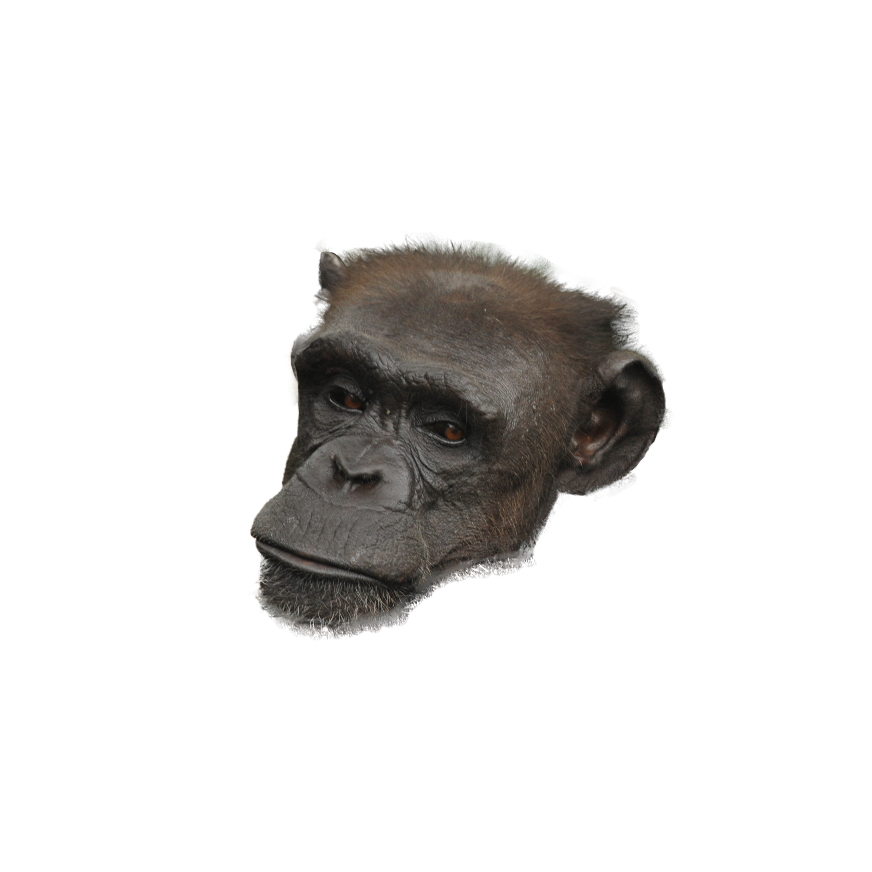
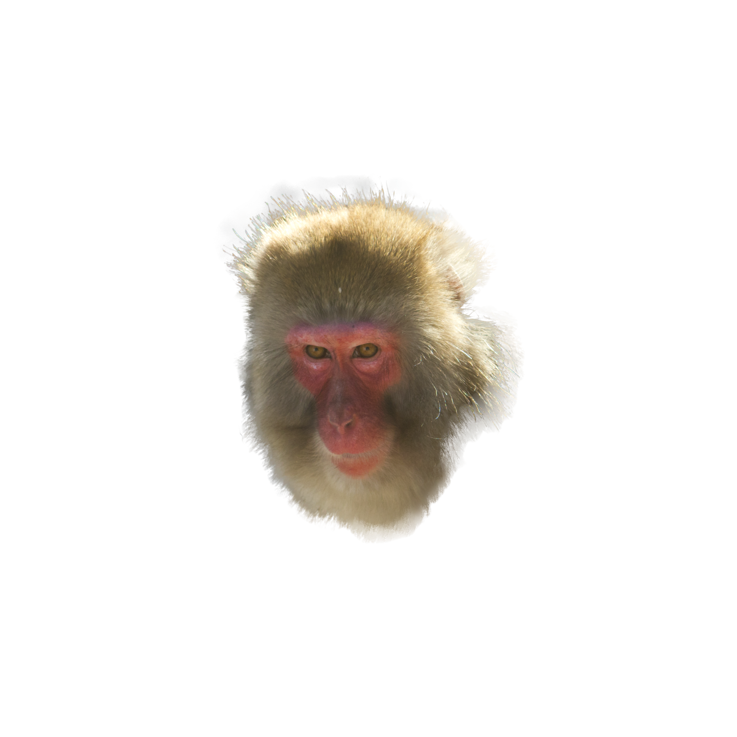
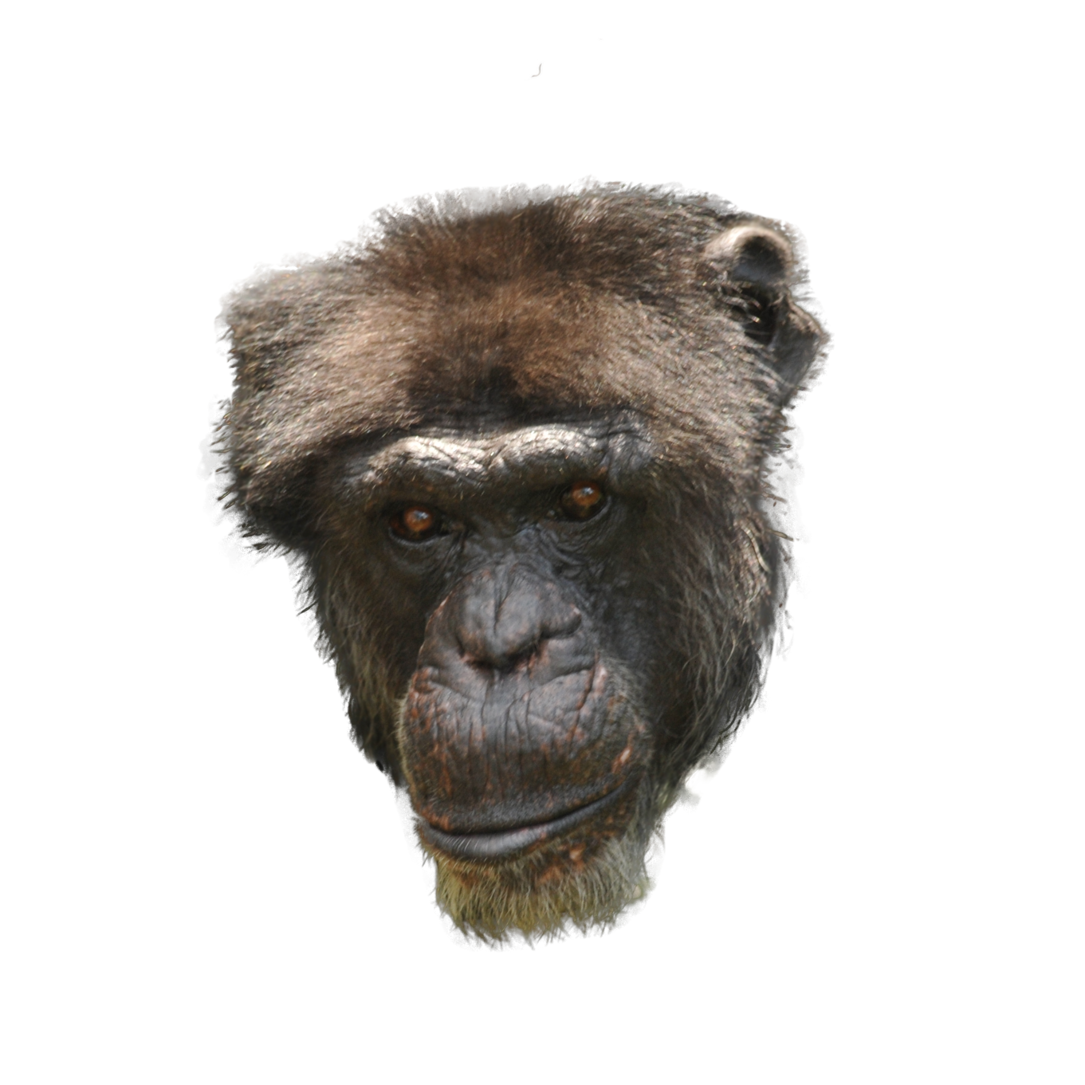
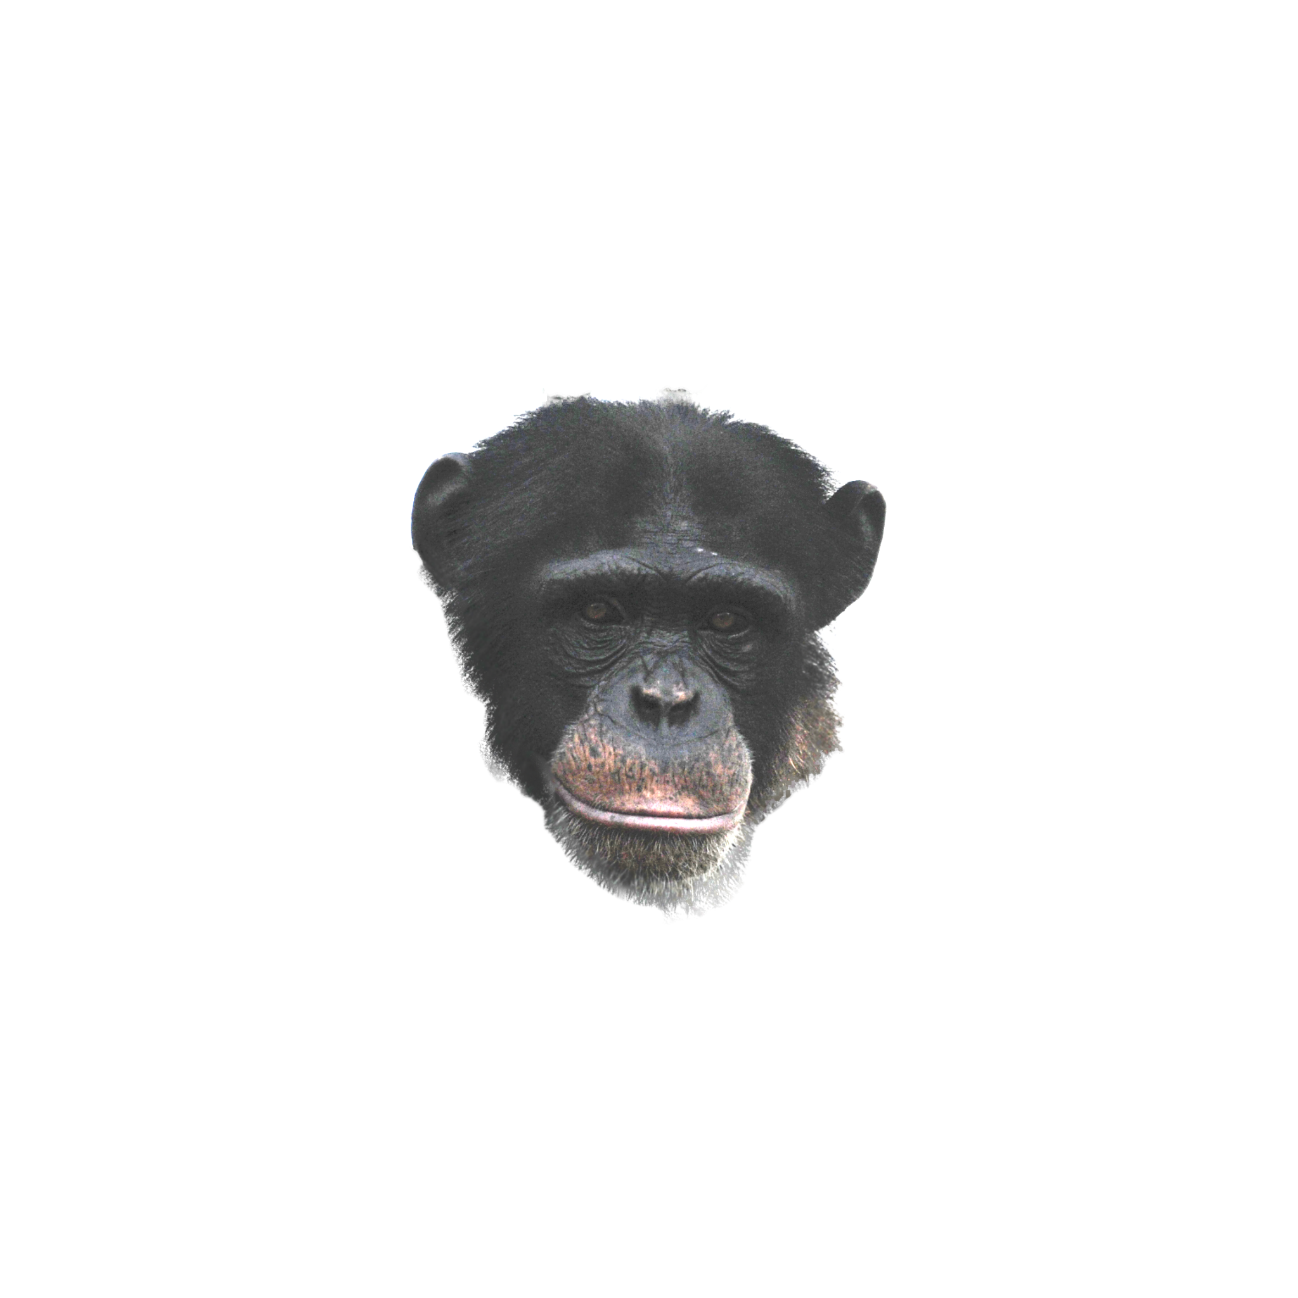
Negative/Positive/Anchor Images
Anchor:
Chimpanzee
(Female/Age:34)
Positive:
30 Images of 3 Chimpanzees
Negative:
30 Images of 3 Rhesus Macaques,
30 Images of Japanese Monkeys

Slide 27
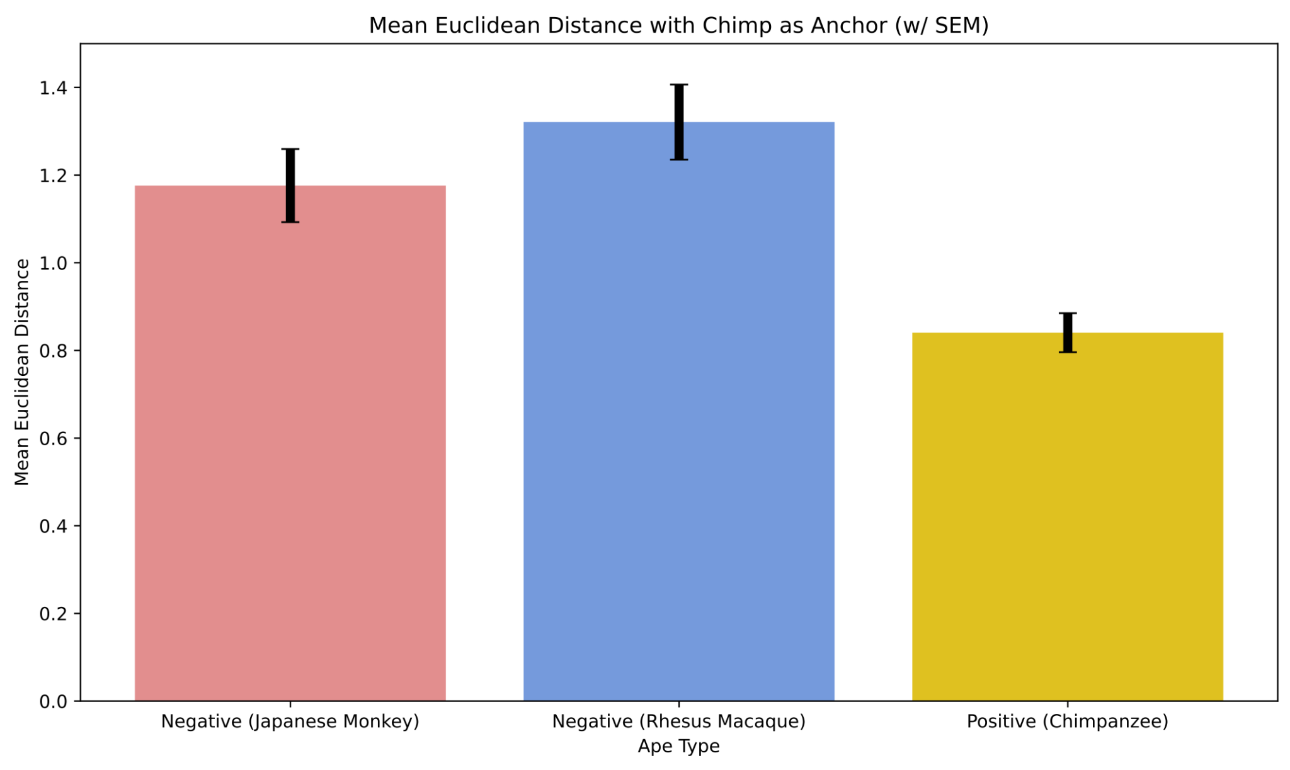
Can FaceNet distinguish Ape Types?
Japanese Monkey vs Chimp:
P = 0.00086
Rhesus Macaque vs Chimp:
P < 8e-6
Notes:
Two sample t-test result
Chimpanzee vs Japanese Monkey: -3.5172920884660357 0.0008633154507542143
Chimpanzee vs Rhesus Macaque: -4.929759063223899 7.463368054808838e-06
Japanese Monkey vs Rhesus Macaque: -1.2115028941462302 0.2306156237544774

Slide 28
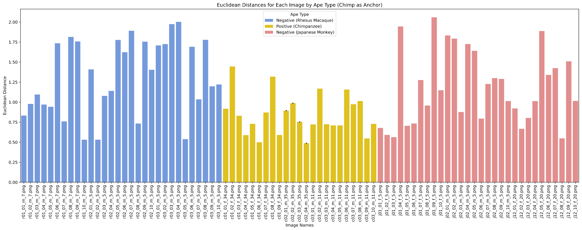
Can FaceNet distinguish Ape Types?

Slide 29
Discussion
Chimpanzees: Chimpanzees are part of the ‘Great Apes’, which also includes humans, gorillas, and orangutans. Chimpanzees are more closely related to humans than they are to either rhesus macaques or Japanese monkeys.
Rhesus Macaque (Macaca mulatta) and Japanese Monkey (Macaca fuscata): Both of these species belong to ‘Old World monkeys’. This family distinction places them further from chimpanzees on the evolutionary tree. Since rhesus macaques and Japanese macaques are both part of the same genus, they are more closely related to each other than either is to the chimpanzee.
Results: Using a Chimp face as an anchor, FaceNet calculated lowest euclidean distances for positive Chimp example images, and higher for negative Rhesus Macaque and Japanese Monkeys.
Side Result (Trend): Rhesus Macaque and Japanese Monkeys had similar level of euclidean distance away from the Chimp anchor - which may indicate FaceNet capturing phenotypic similarities of these two species

Slide 30
Conclusion
FaceNet was able to distinguish between:
Different individuals in our chimp data set
FaceNet was unable to distinguish between:
Different genders within a species in our chimp data set
FaceNet was able to somewhat distinguish between:
Different species (chimps v. rhesus v. jap. monkey)
Different aged individuals in our rhesus macaque data set
FaceNet might have the capability to recognize facial features of animal species that are more closely related to humans on the evolutionary or phylogenetic tree
Evidence: better recognition of chimpanzee data set than rhesus macaque or japanese monkey

Slide 31
Q&A
thank you for your time and attention!

